Slide 1
Digital Graphics
By Hayyan

Slide 2
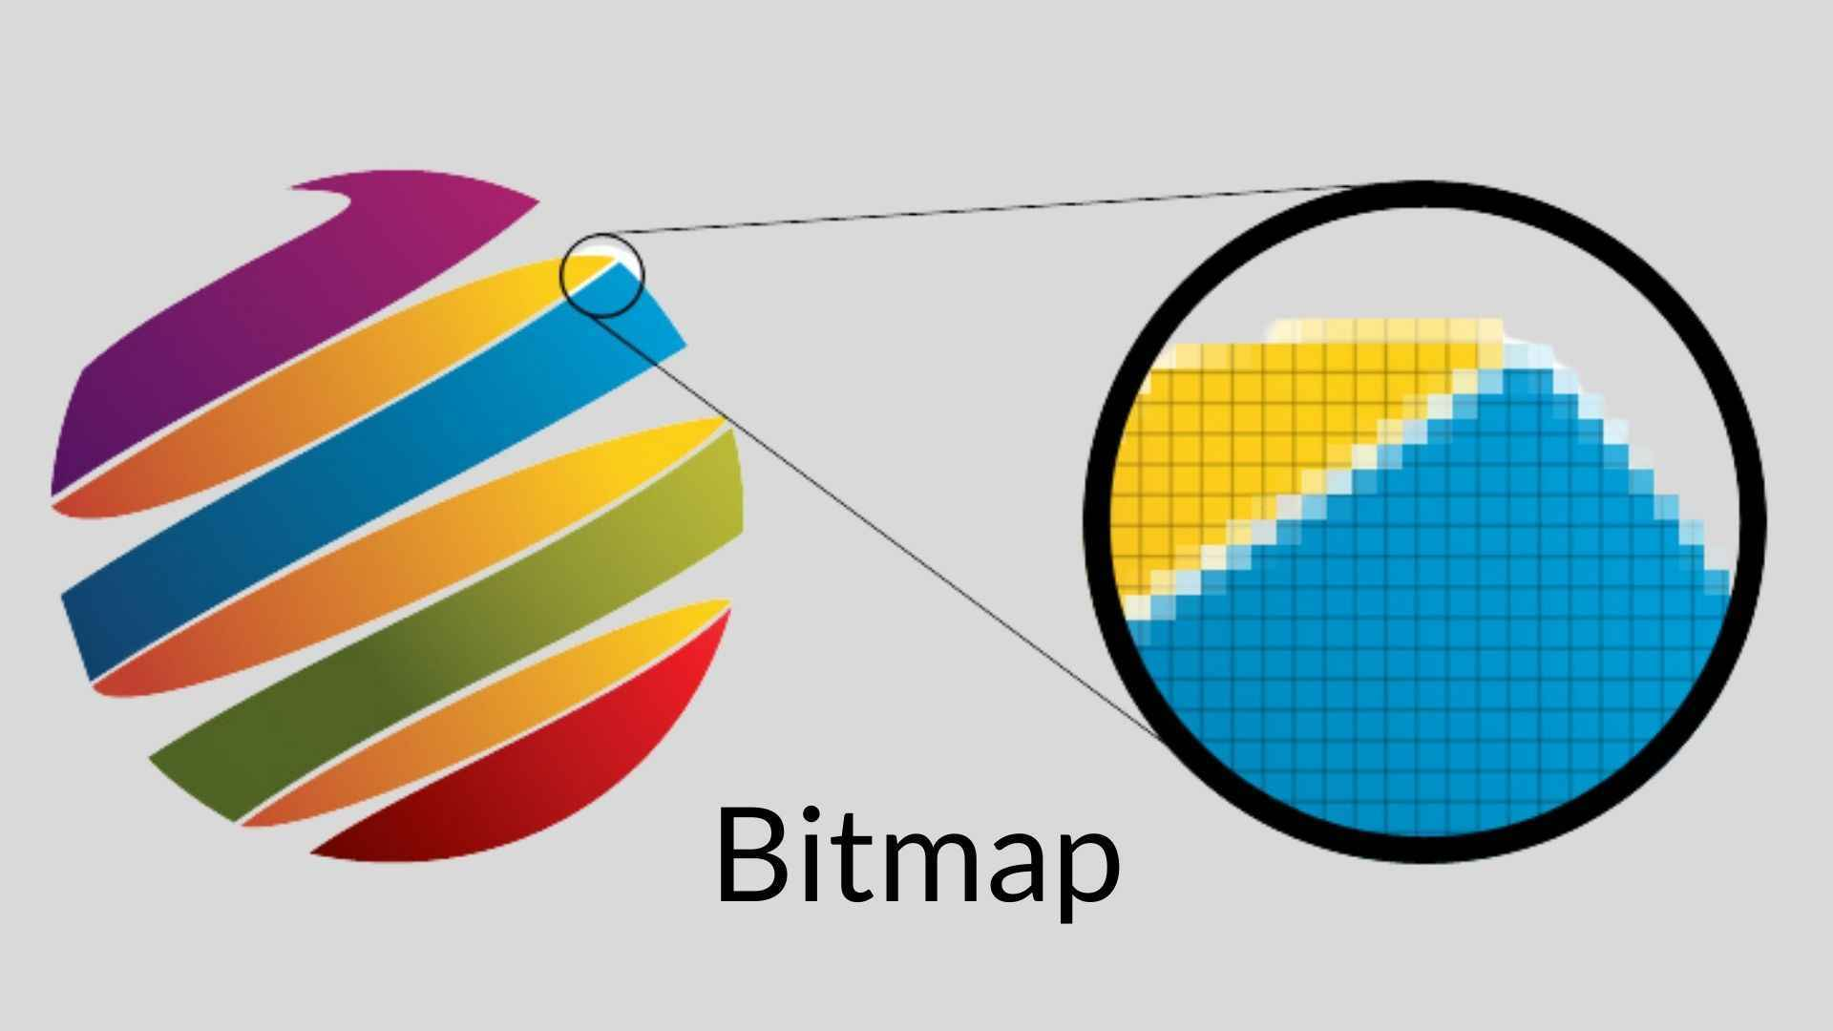
Bitmap Images
A bitmap (or raster) image is an image that is made up of tiny squares called pixels. If you zoom a bitmap image in, the pixels start to become visible and the picture will be blurry.
It can be stored as jpg, jpeg, bmp, tiff or gif.
A bitmap image is quite large, has low resolution and loads quite quickly so websites will often use them as they can advertise their products better and more efficiently.
An advantage of bitmaps is that they can be easily created.
A disadvantage is that they take up a lot of space so it is not used a lot.
Source: https://darvideo.tv/dictionary/bitmap/

Slide 3
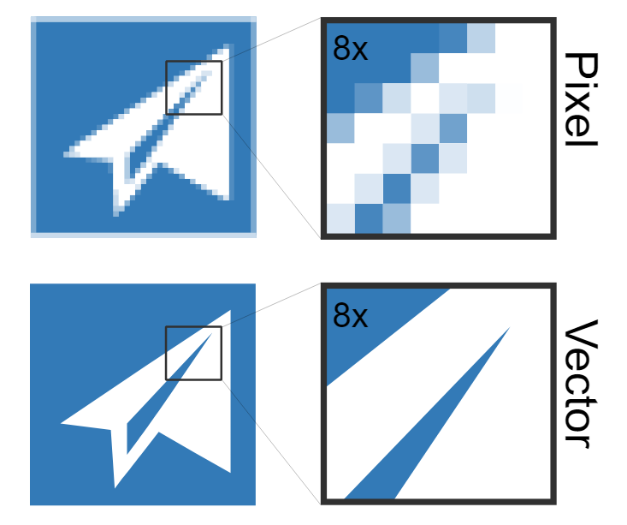
Vector Images
A vector image is an image that is made up of lines and curves. You can change each line if you want to change the colour, size or shape.
It is commonly stored as a pdf file and it is usually used in logos.
An advantage of it is that it is higher quality than bitmap, if you resize an image to make it bigger or smaller, the quality never changes and stays high definition.
However, a disadvantage is that they will take up a lot of space as the file size is very high. Also, it is high quality so you will need a lot of space for that.
Source: https://www.vectorizer.io/

Slide 4
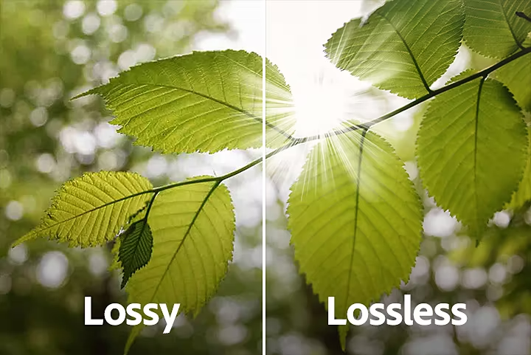
Lossy and Lossless Compression
Lossy is when information is lost from an image. For example, when you compress an image to make it smaller, the file size shrinks so the quality of the image also shrinks.
‘‘Lossless compression means that as the file size is compressed, the picture quality remains the same - it does not get worse. Also, the file can be decompressed to its original quality.” This means that you can still reduce the file size and the image will still be clear. This shows that lossless compression is used more.
https://www.bbc.com/bitesize/guides/zqyrq6f/revision/4
Tuesday 19th February 2019

Slide 5
File formats
File Format | Definition | Advantages and disadvantages
.tiff | It stands for Tagged Image File Format and it is used to store raster images. | An advantage is there is no loss of image detail when a save is made. A disadvantage is that the file size is very big as the compression is not used by default.
.jpg | It is a computer file format that is used for digital images and is commonly used for lossy compression Stands for Joint Photographic Experts Group. | An advantage is that it has a small file size, is compatible and it is displayed correctly in any texts on all devices. A disadvantage is that it is less suitable for working with text and does not support transparency.
.png | ‘‘Stands for Portable Network Group and it is a raster graphics file format that supports lossless data compression.’’ | An advantage is that there is minimum compression loss. This means the image quality doesn’t change by any compression setting. A disadvantage is that it doesn’t support animation and cannot store multiple images into 1 file.
.bmp | ‘‘Also known as bitmap. It is a raster graphics image file format used to store bitmap digital images.’’ | An advantage is that it does not degrade when saved multiple times and it is supported by nearly every device. A disadvantage is there is uncompressed data thus creating huge files.
.gif | Stands for Graphic Interchange Format and it is a lossless format for image files. | An advantage is that they are easy to use when creating webpages and they are supported by all web browsers. A disadvantage is that they can slow a webpage down if a large number of them is used.
.pdf | Stands for Portable Document Format and is a file format for capturing and sending electrical documents. | An advantage is that it is easy to view as Adobe Acrobat Reader is often pre-installed onto your computer so it is free. A disadvantage is that it is not free to edit PDF files.
.psd | It is a Photoshop Document and it is the default format that Photoshop uses to save data. | An advantage is that it can help to utilize all of Photoshop's features. A disadvantage is that it is a big file size.

Slide 6
Reference from the table
png. ‘‘Stands for Portable Network Group and it is a raster graphics file format that supports lossless data compression.’’ It is mainly used in web images because the images need to be of good quality so the audience will be able to see them clearly.
https://en.wikipedia.org/wiki/Portable_Network_Graphics
Tuesday 19th February 2019
bmp. ‘‘Also known as bitmap. It is a raster graphics image file format used to store bitmap digital images.’’ It is commonly used and is compatible on multiple devices.
https://en.wikipedia.org/wiki/BMP_file_format
Tuesday 19th February 2019

Slide 7
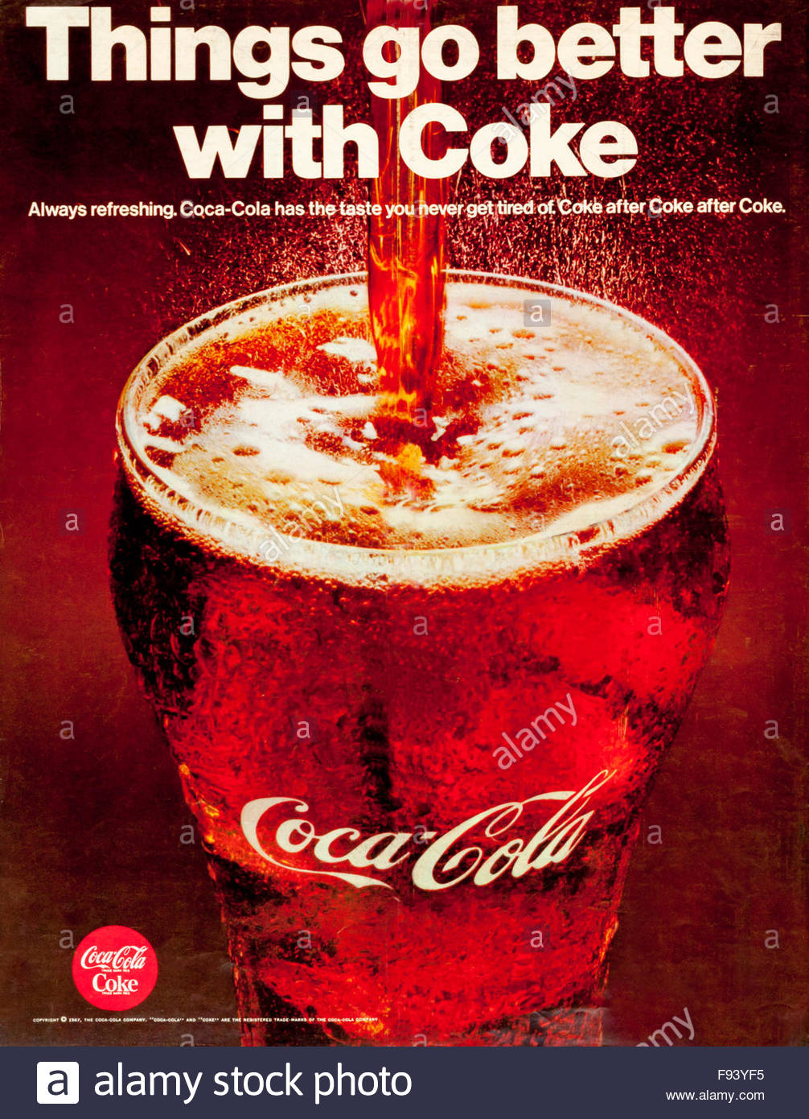
This poster influenced my game design as it has a slogan which makes it look eye-catching and makes you want to buy it. I included a slogan in my magazine advert as it will capture the attention of the target audience and they will want to buy it as they will want to know what the game is about.

